Slide 1
Neighborhoods and income mobility
EC137 {10-02}
08 April 2021

Slide 2
The Fading American Dream
Percent of Children Earning More than Their Parents, by Year of Birth
100
90
80
Pct. of Children Earning more than their Parents
70
60
50
1940
1950
1960
1970
1980
Child's Year of Birth
Source: Chetty, Grusky, Hell, Hendren, Manduca, Narang (Science 2017)

Slide 3
Differences in Opportunity Across Local Areas
How do children’s chances of moving up vary across areas in America?
Are there some areas where kids do better than others? If so, what lessons can we learn from them?

Slide 4
The Opportunity Atlas Data Sources and Sample Definitions
Data sources: Anonymized Census data (2000, 2010, ACS) covering U.S. population linked to federal income tax returns from 1989-2015
Link children to parents based on dependent claiming on tax returns
Target sample: Children in 1978-83 birth cohorts who were born in the U.S. or are authorized immigrants who came to the U.S. in childhood
Analysis sample: 20.5 million children, 96% coverage rate of target sample

Slide 5
Measuring Parents’ and Children’s Incomes in Tax Data
Parents’ household incomes: average income reported on Form 1040 tax return from 1994-2000
Children’s incomes measured from tax returns in 2014-15 (ages 31-37)
Focus on percentile ranks in national distribution:
Rank children relative to others born in the same year and parents relative to other parents

Slide 6
Intergenerational Income Mobility for Children Raised in Chicago
Average Child Household Income Rank vs. Parent Household Income Rank
70
60
50
Mean Child Rank in National Income Distribution
40
Predicted Value Given Parents at 25th Pctile.
= 40th Percentile
= $30,400
30
20
0
10
20
30
40
50
60
70
80
90
100
Source: Chetty, Hendren, Kline, Saez 2014
Parent Rank in National Income Distribution

Slide 7
Intergenerational Income Mobility for Children Raised in a Hypothetical Census Tract
Average Child Household Income Rank vs. Parent Household Income Rank
70
60
50
Mean Child Rank in National Income Distribution
40
Predicted Value Given Parents at 25th Percentile
= 40th Percentile
30
20
0
10
20
30
40
50
60
70
80
90
100
Parent Rank in National Income Distribution

Slide 8
Estimating Children’s Average Outcomes by Census Tract
Run a separate regression using data for children who grow up in each Census tract in America
In practice, many children move across areas in childhood
Weight children by fraction of childhood (up to age 23) spent in a given area

Slide 9
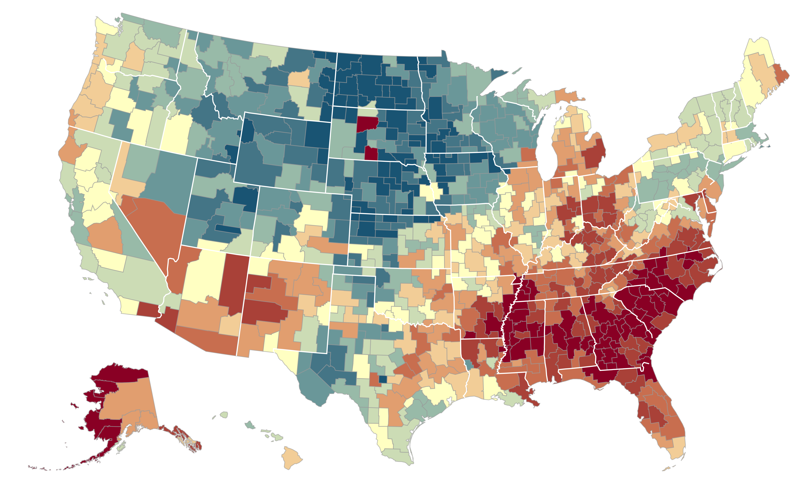

The Geography of Upward Mobility in the United States
Average Household Income for Children with Parents Earning $27,000 (25th percentile)
Seattle $35.2k
Salt Lake City $37.2k
Dubuque $45.5k
Cleveland $29.4k
Boston $36.8k
New York City $35.4k
San Francisco
Bay Area
$37.2k
Washington DC $33.9k
> $44.8k
Los Angeles $34.3k
Atlanta $26.6k
$33.7k
Note: Blue = More Upward Mobility, Red = Less Upward Mobility
Source: The Opportunity Atlas. Chetty, Friedman, Hendren, Jones, Porter 2018
< $26.8k

